Slide 1
Program Name goes here
Link to github Repository: https://github.com/DavidLocke1/Pizza_Bot
Links to trello board / project management tools:
https://trello.com/b/LWPTyqJt/pizza-bot-initial-plan
You MUST provide evidence showing how the problem has been decomposed, how the components have been developed and trialled, and of how they have been assembled and tested to create a final, working outcome.

Slide 2
Relevant Implications
Explain the relevant implications here. Please watch this video to learn how to do this.
Notes:
Explain the relevant implications here. Then as you work, develop your code, discuss how the implications are being met.

Slide 3
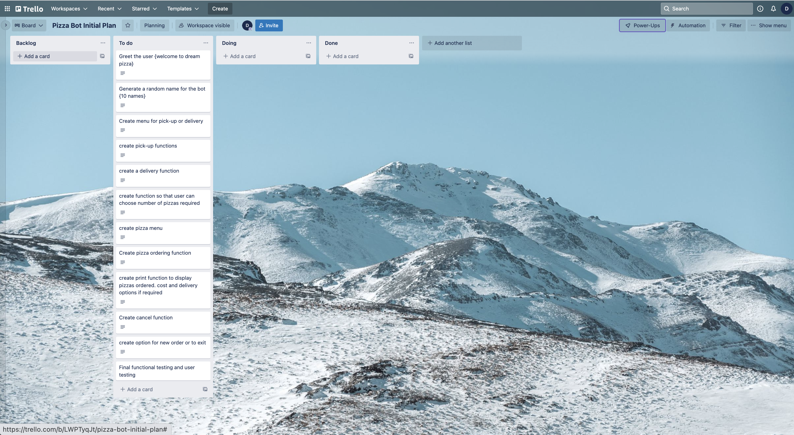
Decomposition
Notes:
Paste screenshots of your initial Trello board / task decomposition on this slide. If you have a long list, you might need to break it up into several columns. Delete this instruction when you are done.

Slide 4
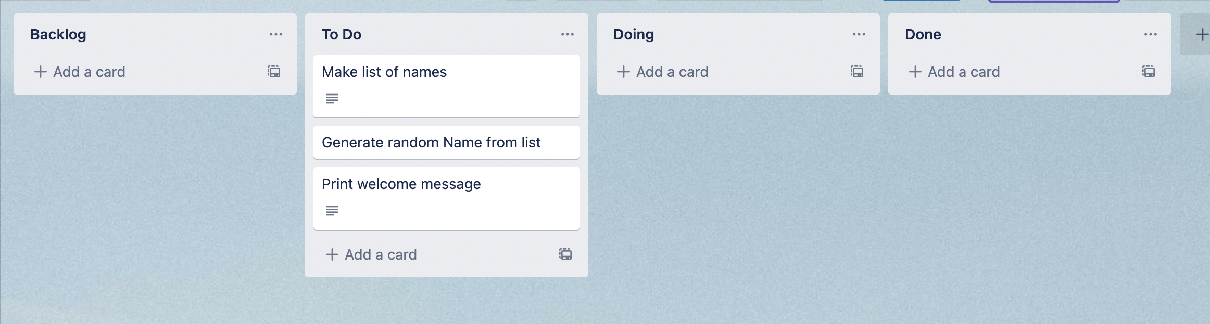
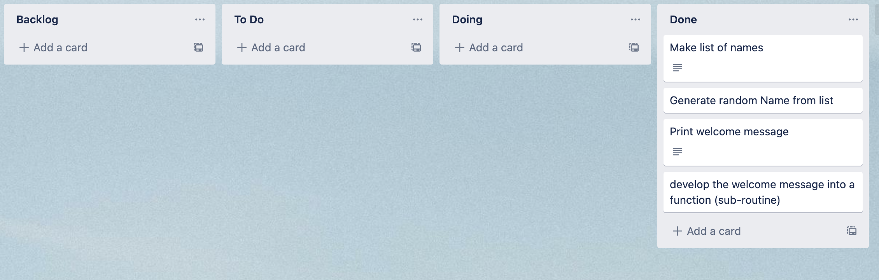
Component 1 (Trello screenshot)
Version 1
Version 2

Slide 5
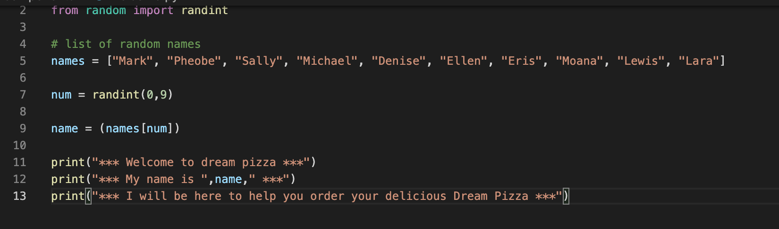
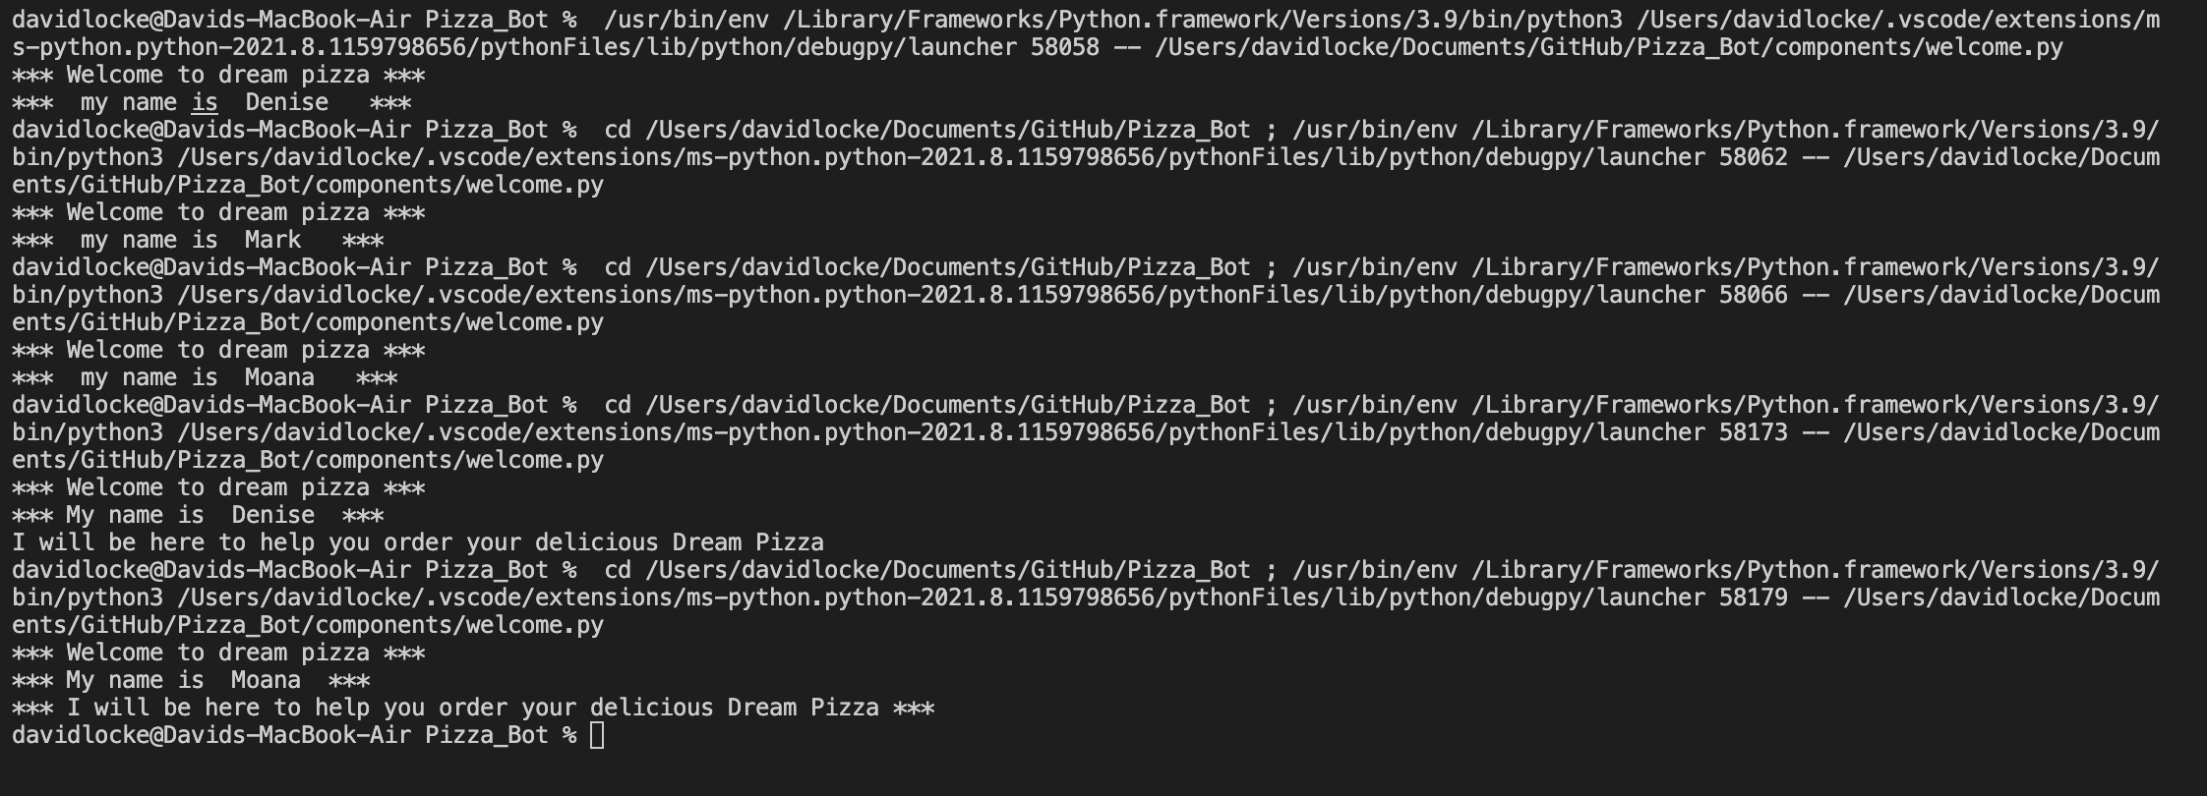
Component 1 - Test Plan (?and screenshot)
Test Case | Expected Values
Run program | Print welcome message with random name from list of names – runs correctly

Slide 6
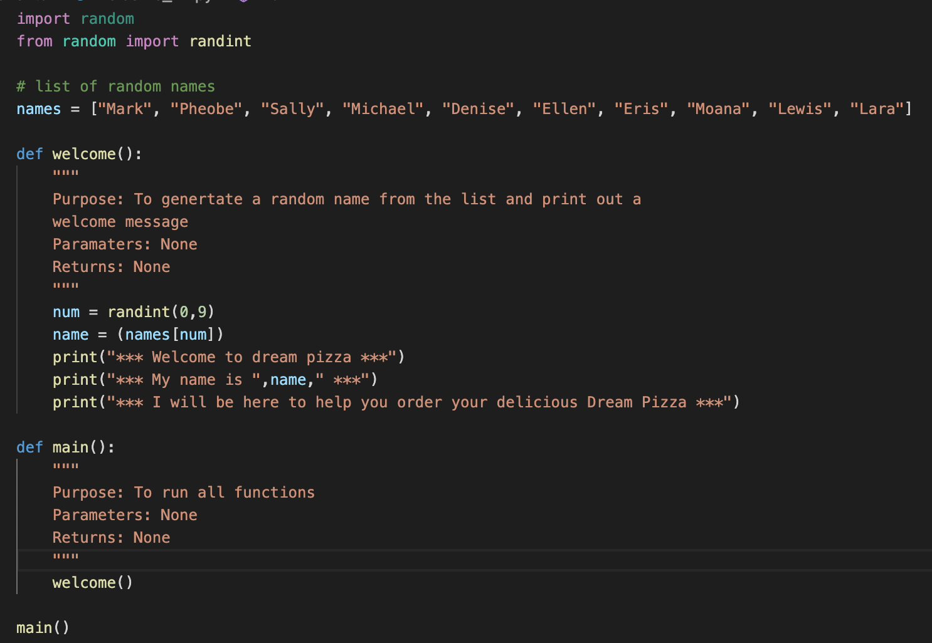
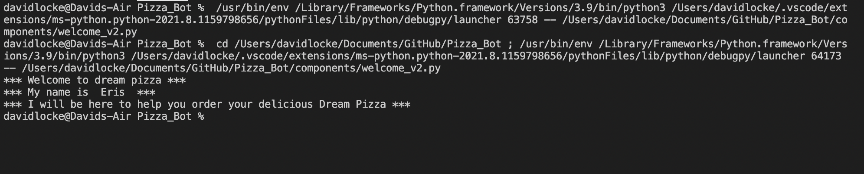
Component 1 version 2 - Test Plan (?and screenshot)
Test Case | Expected Values
Run program | Main and welcome run correctly Welcome message prints with random name

Slide 7
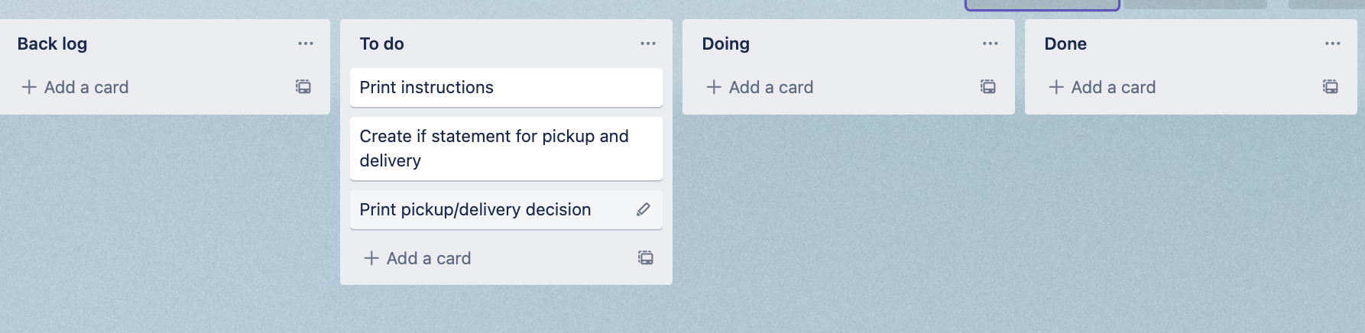
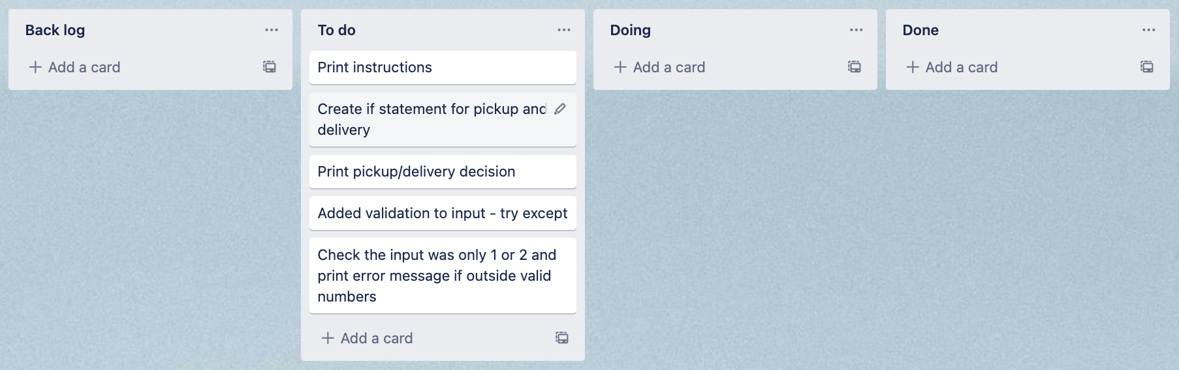
Component 2 (Trello screenshot)

Slide 8
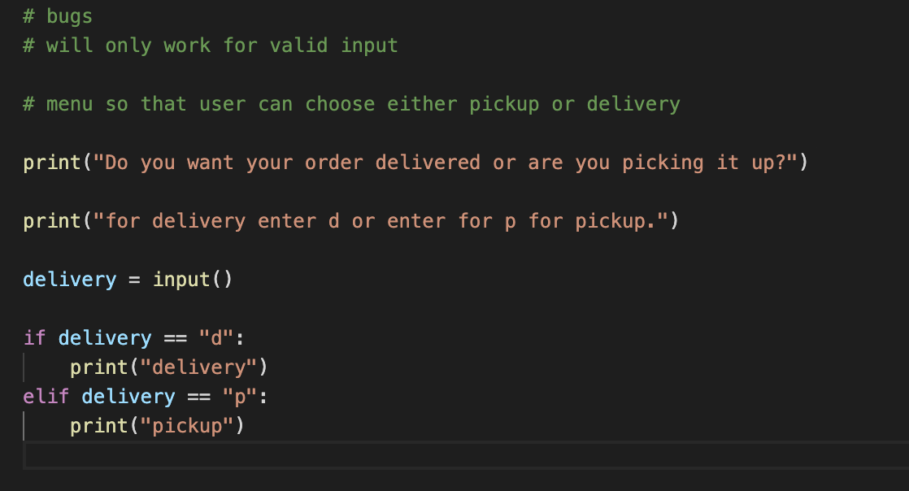
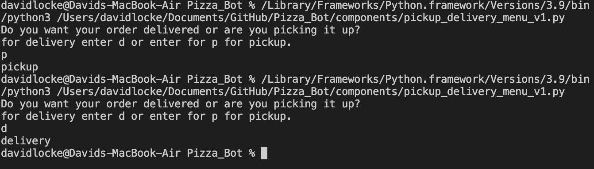
Component 2 version 1 - Test Plan (?and screenshot)
Test Case | Expected Values
Run program | Enter p program prints pickup Enter d program prints delivery Enter invalid program stops

Slide 9
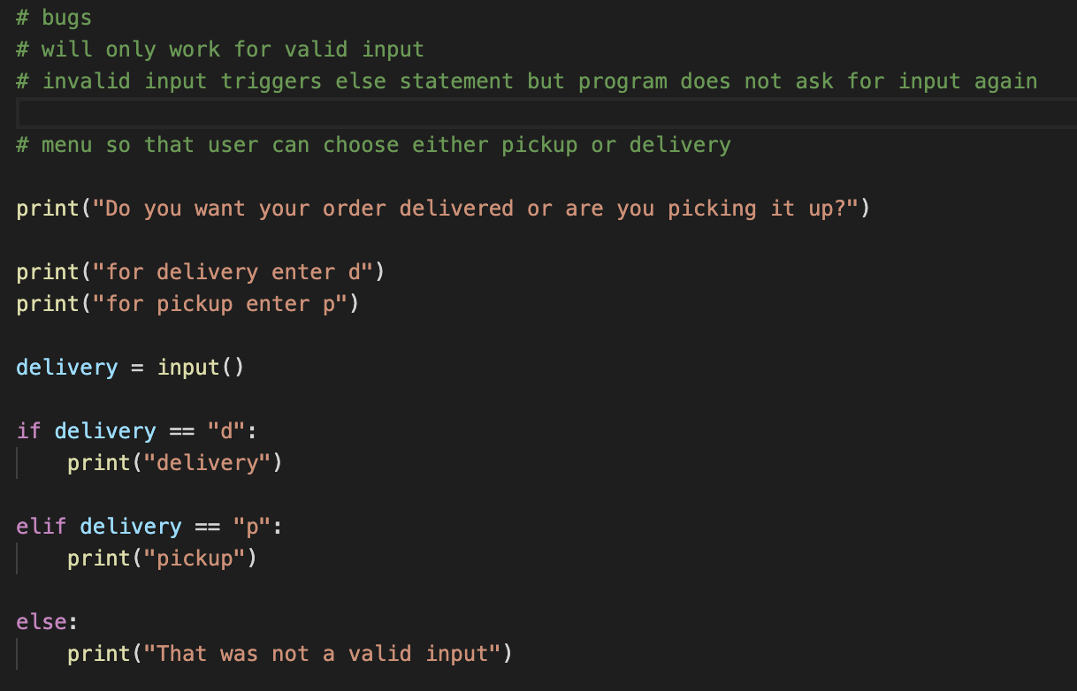
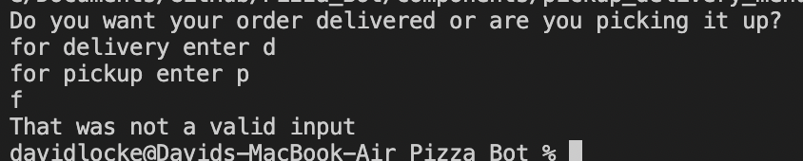
Component 2 – Version 2 (?and screenshot)
Test Case | Expected Values
Run program | Enter p program prints pickup Enter d program prints delivery Enter invalid prints error message

Slide 10
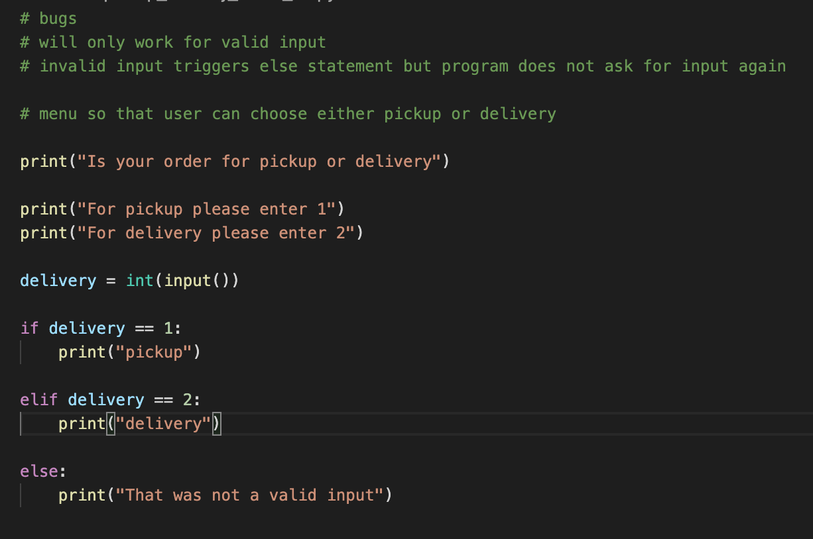
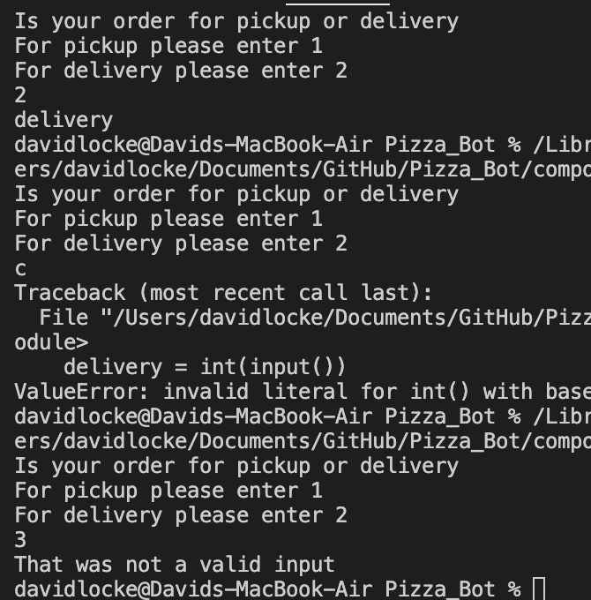
Component 2 – Version 3 (?and screenshot)
Test Case | Expected Values
Run program | Enter 1 program prints pickup Enter 2 program prints delivery Enter invalid programs displays value error

Slide 11
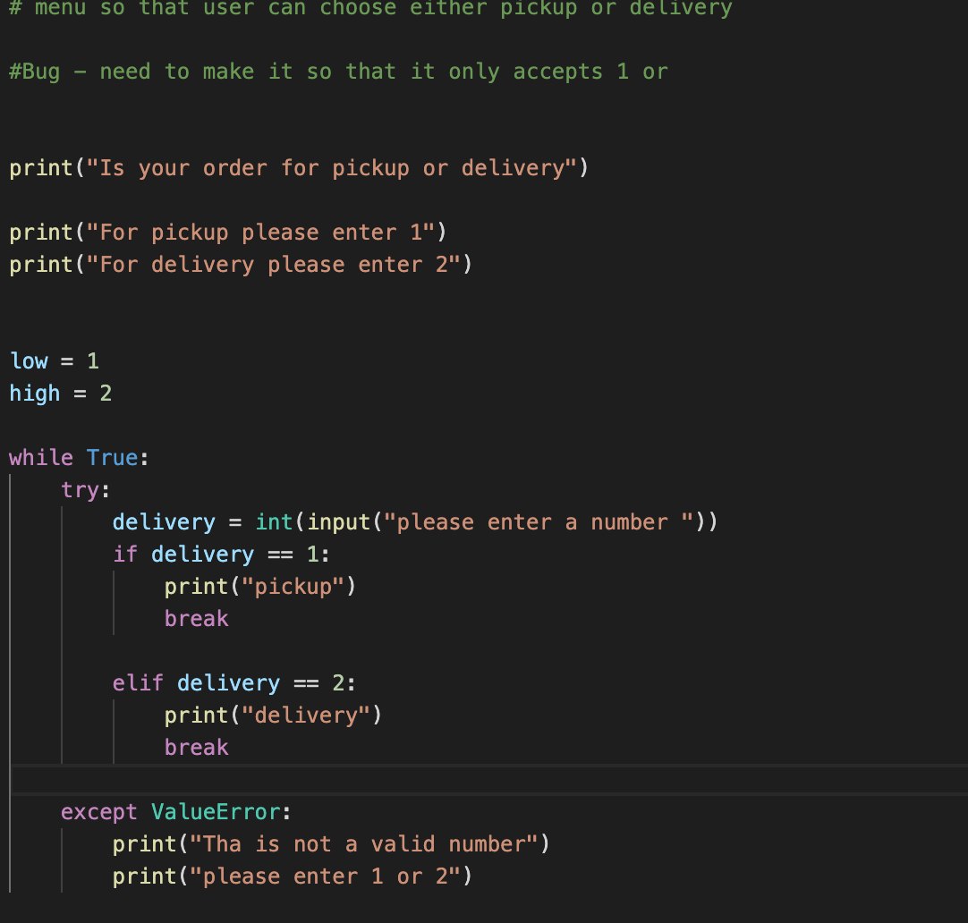
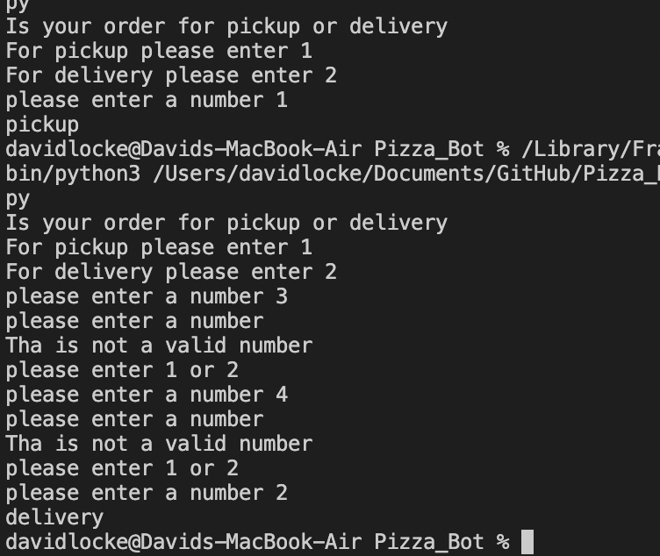
Component 2 – Version 4 (?and screenshot)
Test Case | Expected Values
Run program | Enter 1 program prints pickup Enter 2 program prints delivery Enter invalid prints an Error message Enter number other then 1 or 2 does not work

Slide 12
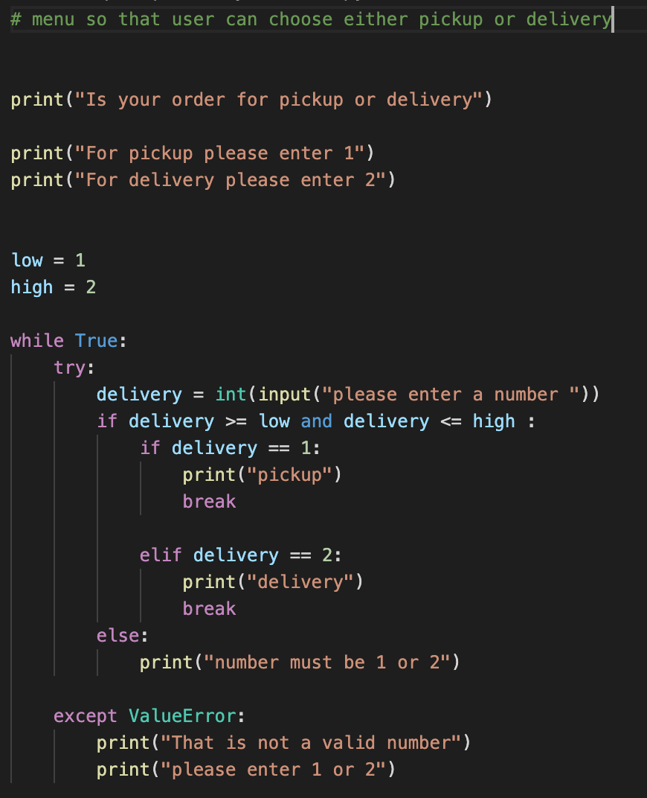
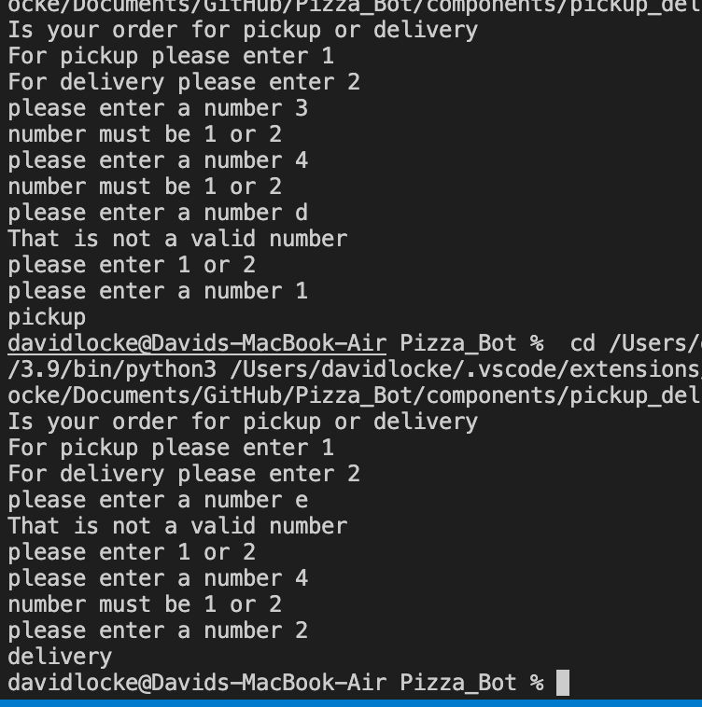
Component 2 – Version 5 (?and screenshot)
Test Case | Expected Values
Run program | Enter 1 program prints pickup Enter 2 program prints delivery Enter invalid entry - prints an Error message asks for input again Enter number other then 1 or 2 – error message asks for entry again

Slide 13
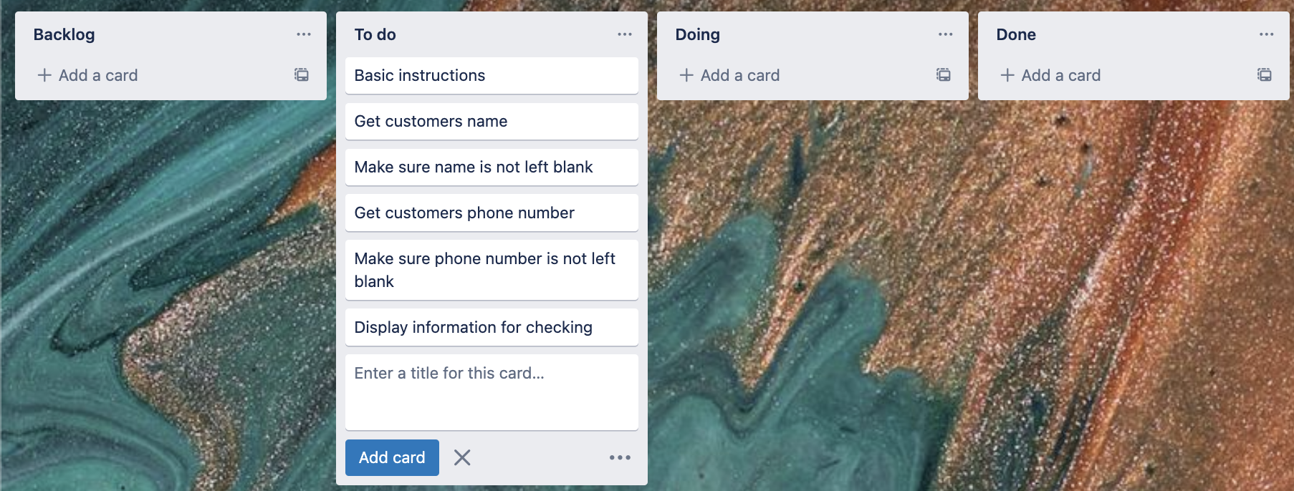
Component 3 Pick up info(Trello screenshot)

Slide 14
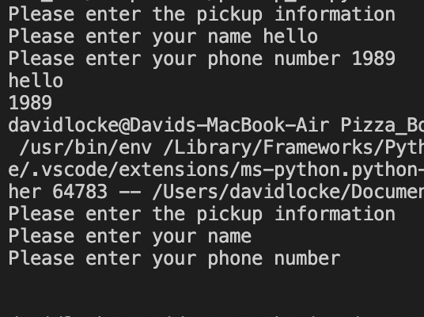
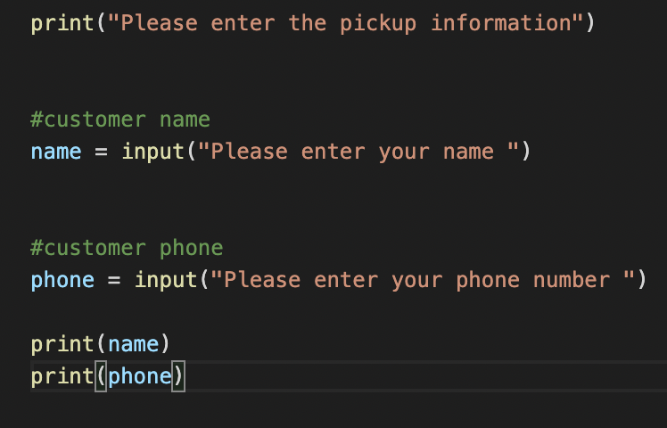
Component 3 version 1 - Test Plan (?and screenshot)
Test Case | Expected Values
Input name Input phone Input blank | Printed name correctly Printed phone number correctly Accepted blank and printed blank

Slide 15
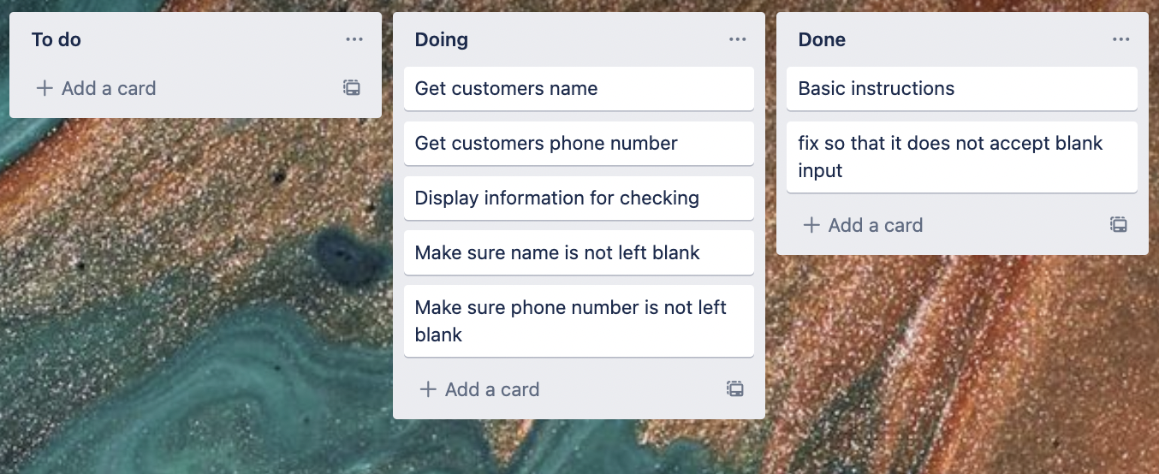
Component 3 Pick up info v2(Trello screenshot)

Slide 16
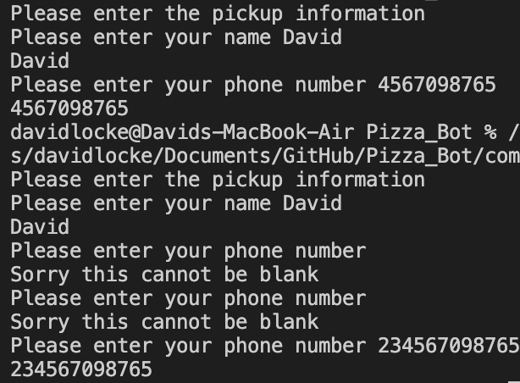
Component 3 version 2 - Test Plan (?and screenshot)
Test Case | Expected Values
Input name Input phone Input blank | Printed name correctly Printed phone number correctly Prints “Sorry this cannot be blank - and goes back to input”

Slide 17
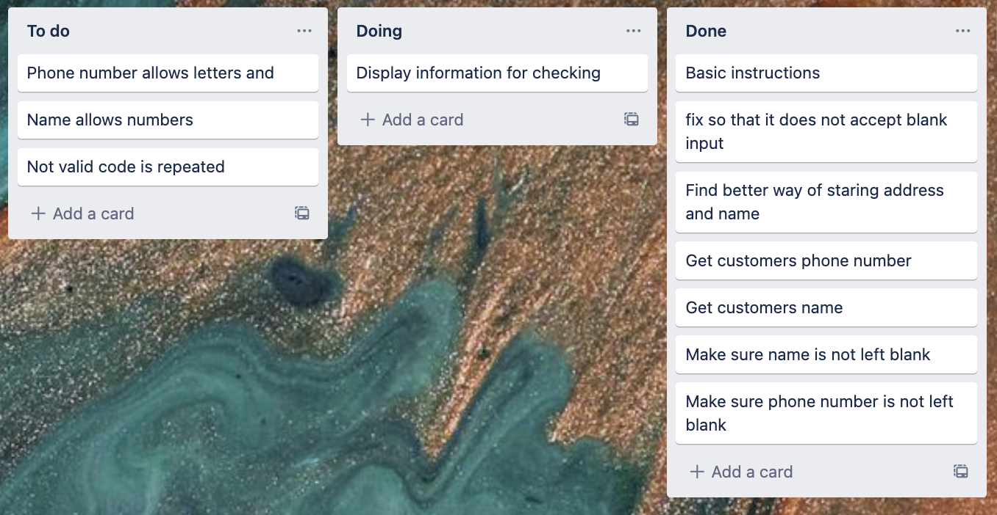
Component 3 Pick up info v3(Trello screenshot)

Slide 18
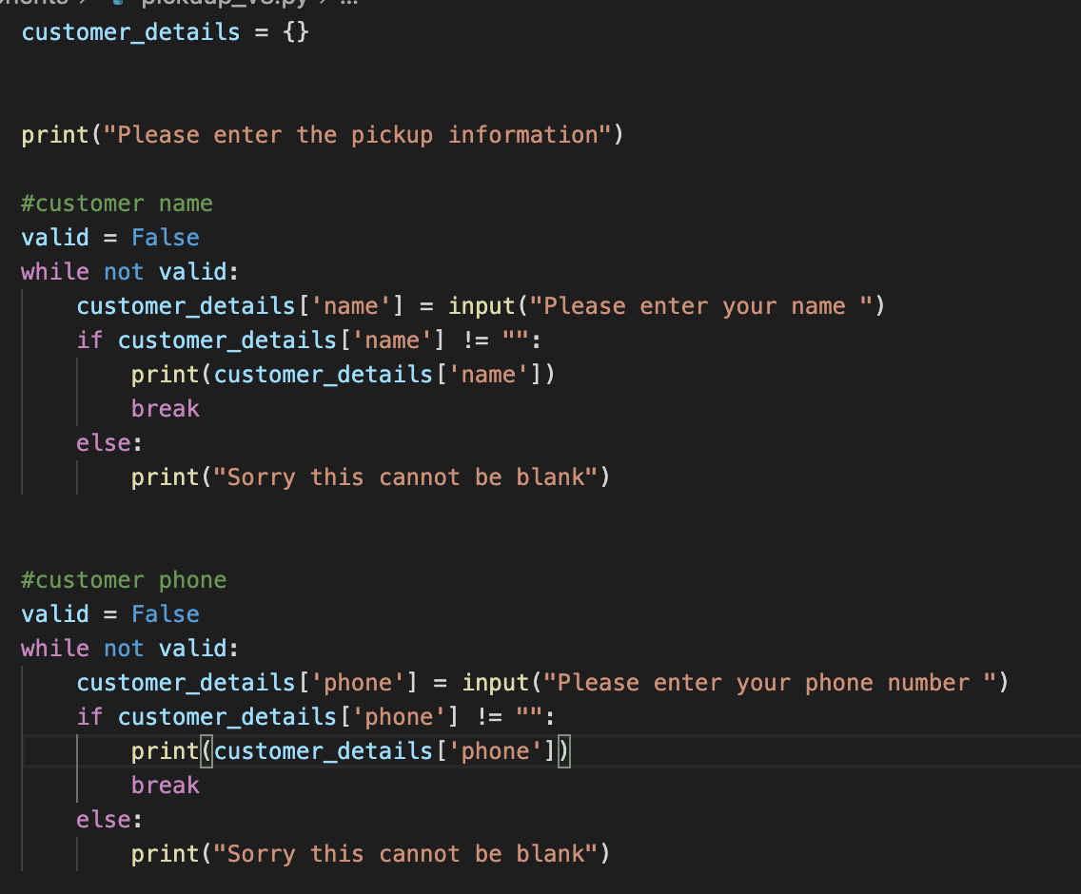
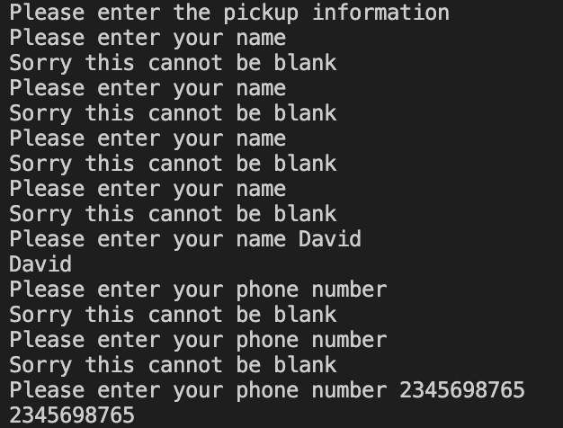
Component 3 version 3 - Test Plan (?and screenshot)
Test Case | Expected Values
Input name Input phone Input blank | Printed name correctly Printed phone number correctly Prints “Sorry this cannot be blank - and goes back to input”

Slide 19
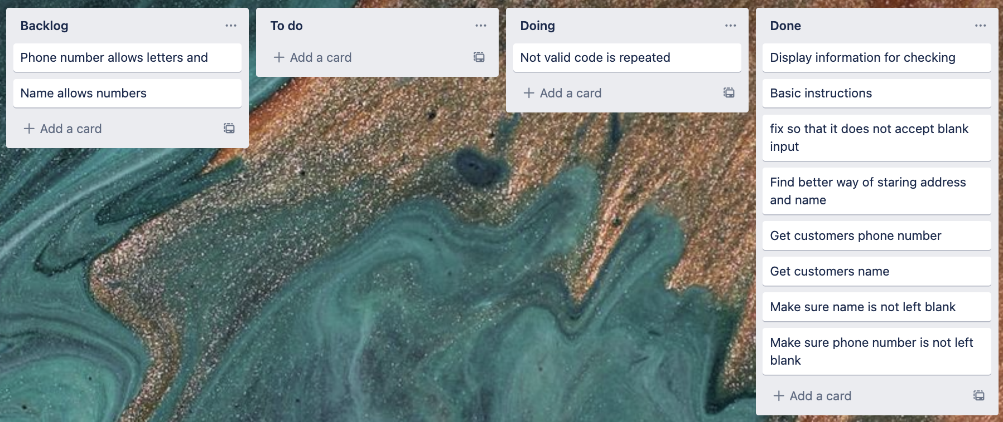
Component 3 Pick up info v4(Trello screenshot)

Slide 20
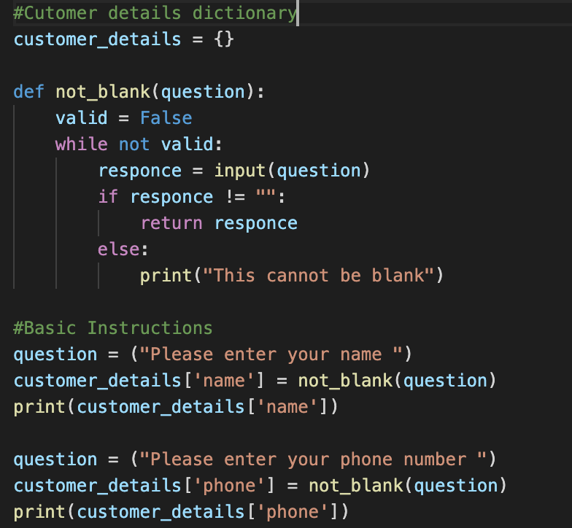
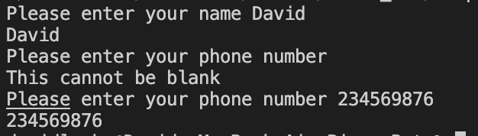
Component 3 version 4 - Test Plan (?and screenshot)
Test Case | Expected Values
Input name Input phone Input blank | Printed name correctly Printed phone number correctly Prints “Sorry this cannot be blank - and goes back to input”

Slide 21
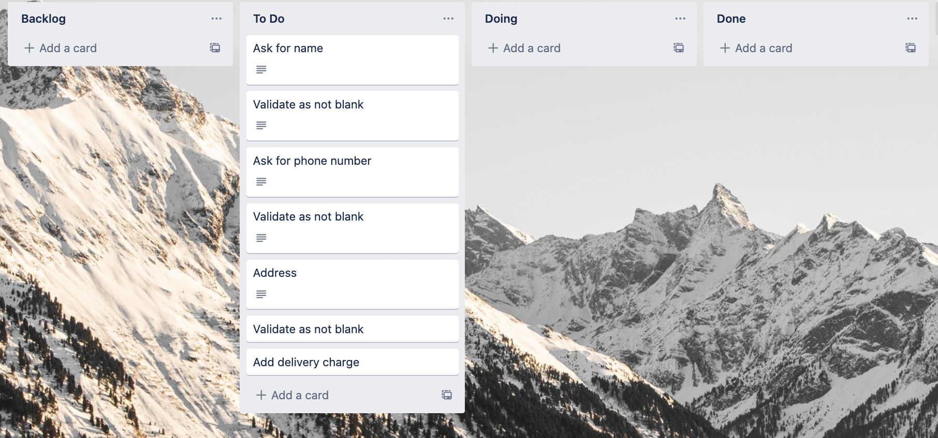
Component 4 delivery info v1 (Trello screenshot)

Slide 22
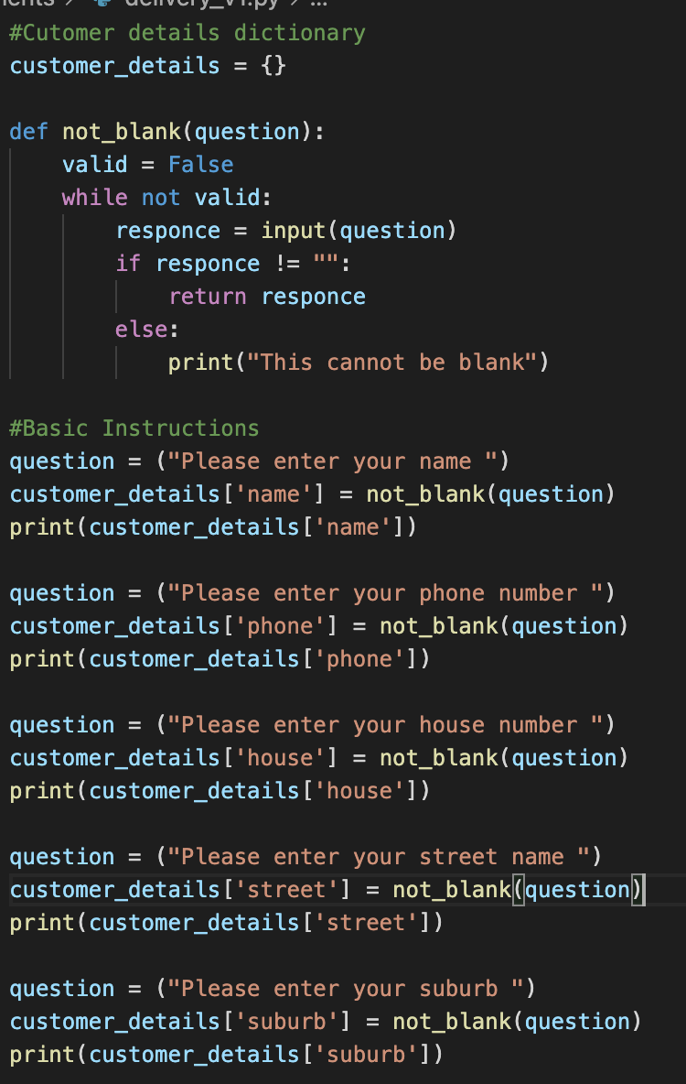
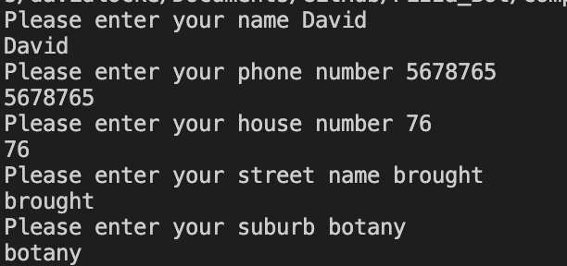
Component 4 v1 - Test Plan (?and screenshot)
Test Case | Expected Values
Input name Input phone number Input house number Input street name Input suburb Left input blank | Printed name correctly Printed phone number Printed house number Printed street name Printed suburb Asked question again

Slide 23
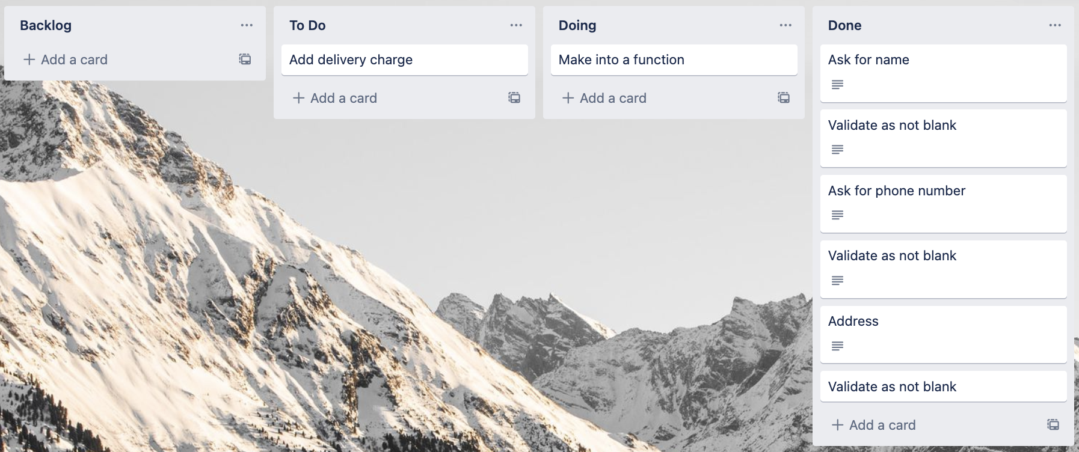
Component 4 delivery info v2 (Trello screenshot)

Slide 24
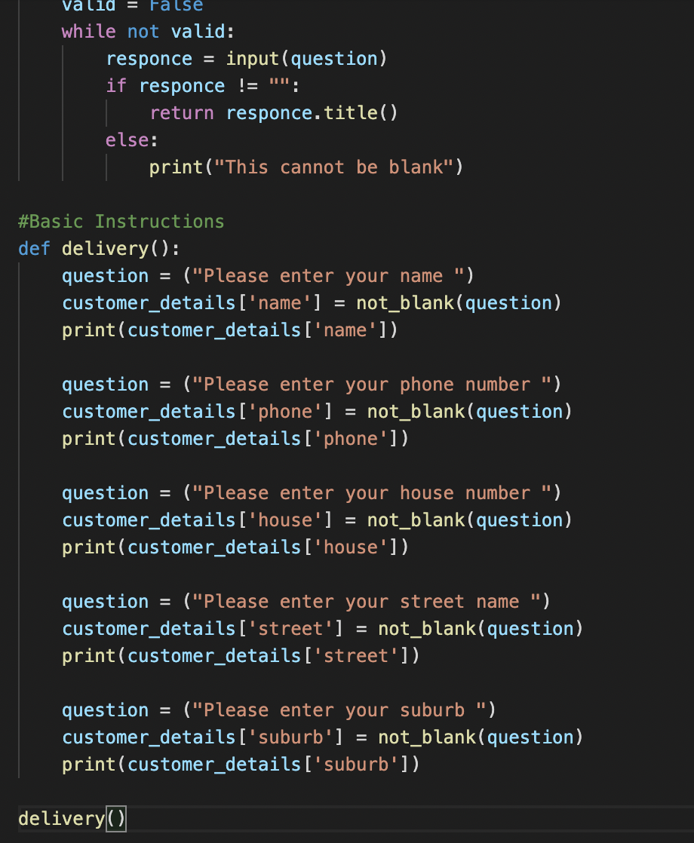
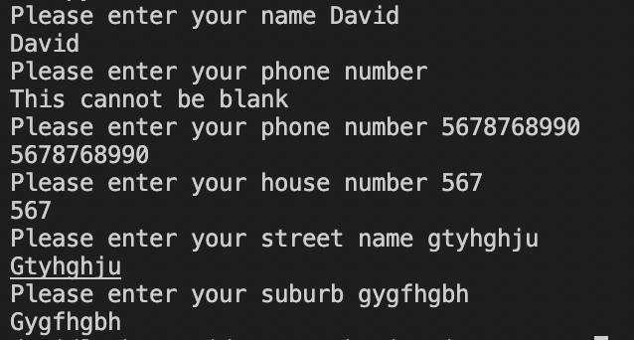
Component 4 v2 - Test Plan (?and screenshot)
Test Case | Expected Values
Input name Input phone number Input house number Input street name Input suburb Left input blank | Printed name correctly Printed phone number Printed house number Printed street name Printed suburb name Asked question again

Slide 25
Component 4 delivery info (Trello screenshot)

Slide 26
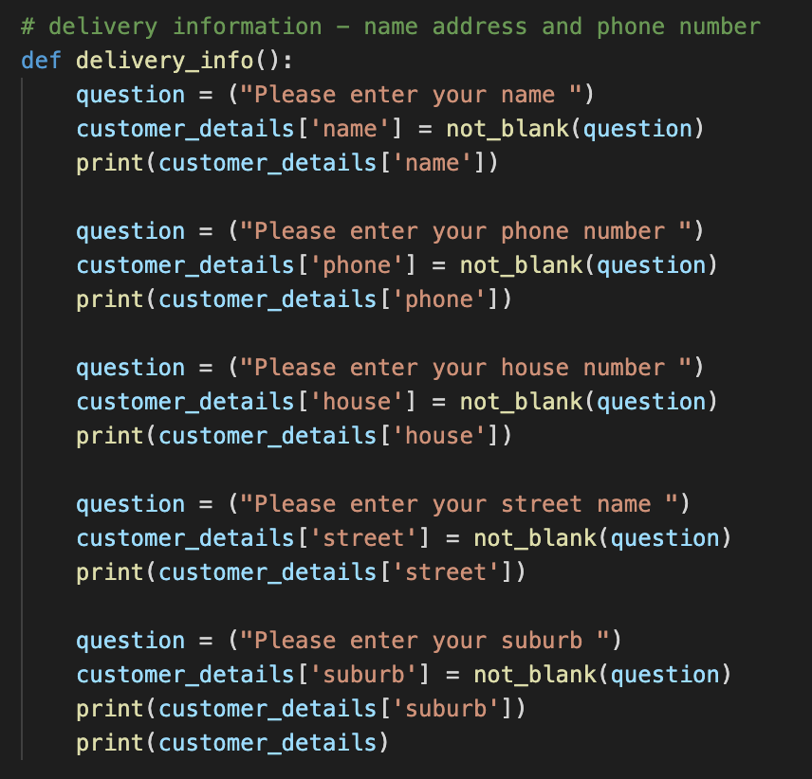
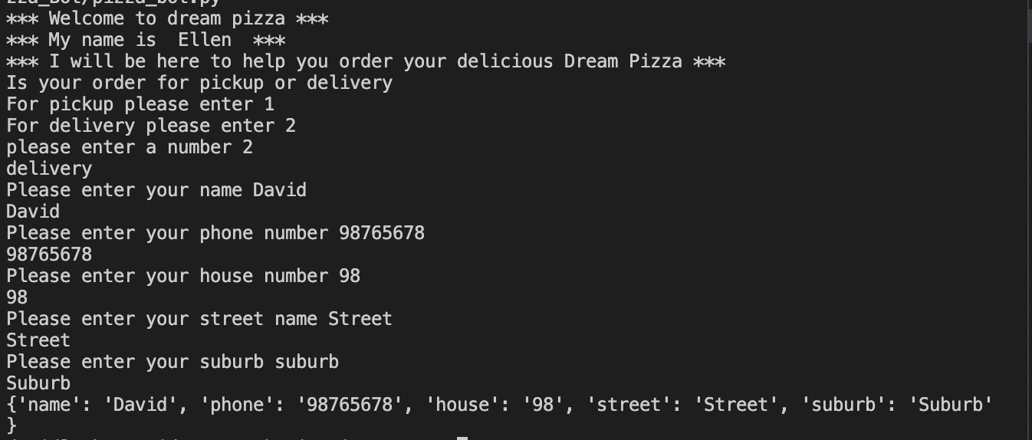
Component 4 v2 - Test Plan (?and screenshot)
Test Case | Expected Values
Input name Input phone number Input house number Input street name Input suburb Left input blank | Printed name correctly Printed phone number Printed house number Printed street name Printed suburb name Asked question again

Slide 27
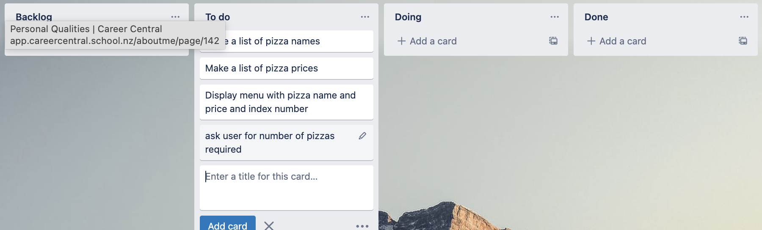
Component 5 Pizza Menu version 1 (Trello screenshot)

Slide 28
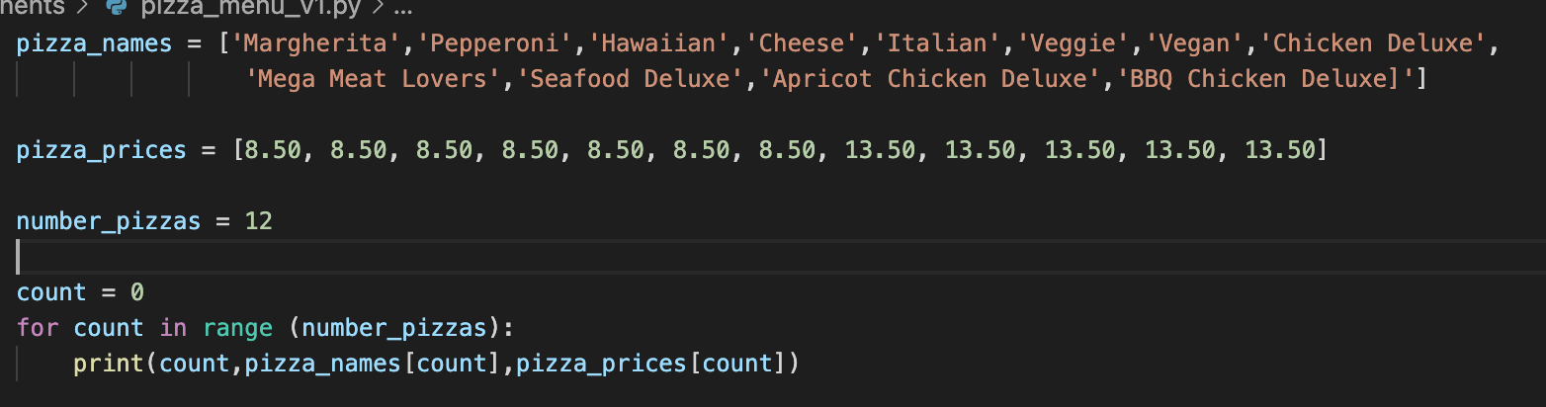
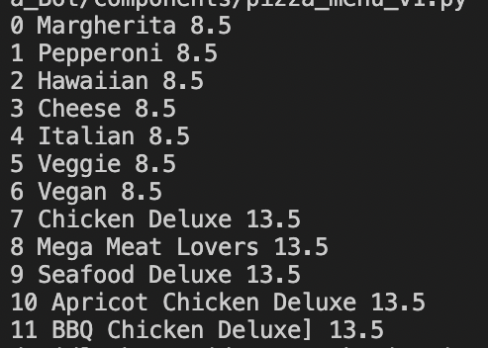
Component 5 v1 - Test Plan (?and screenshot)
Test Case | Expected Values
Run file | Printed a list with index number, of pizzas and prices

Slide 29
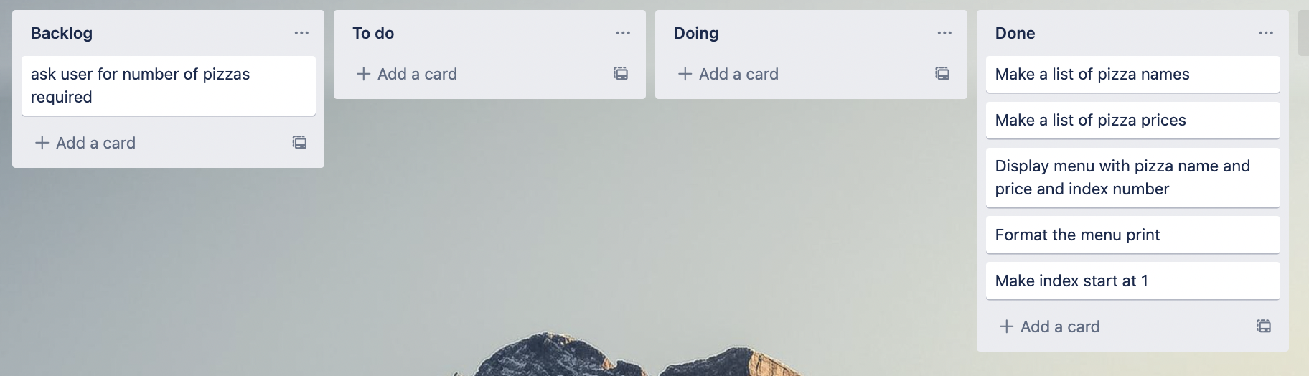
Component 5 Pizza Menu version 2 (Trello screenshot)

Slide 30
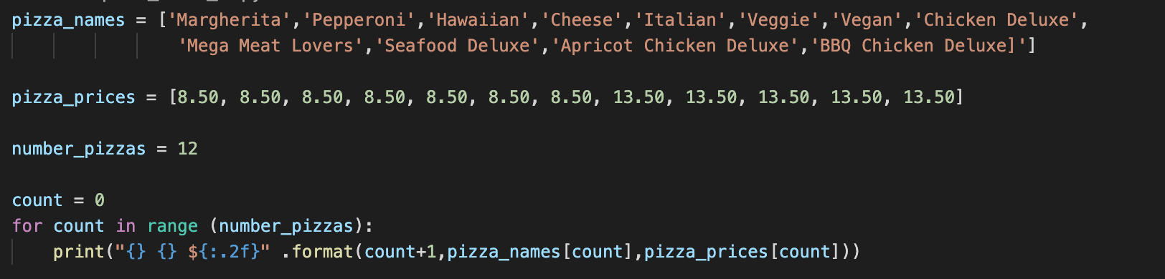
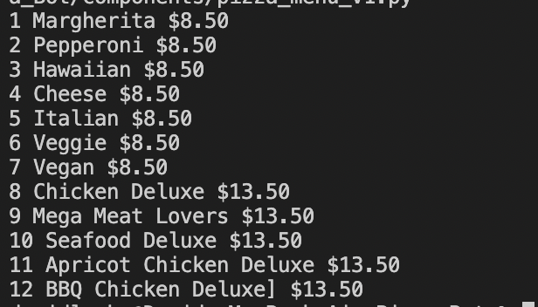
Component 5 v2 - Test Plan (?and screenshot)
Test Case | Expected Values
Run file | Printed a list with index number, of pizzas and prices with price formatted to 2 decimal places and dollar sign. Menu starts at 1.

Slide 31
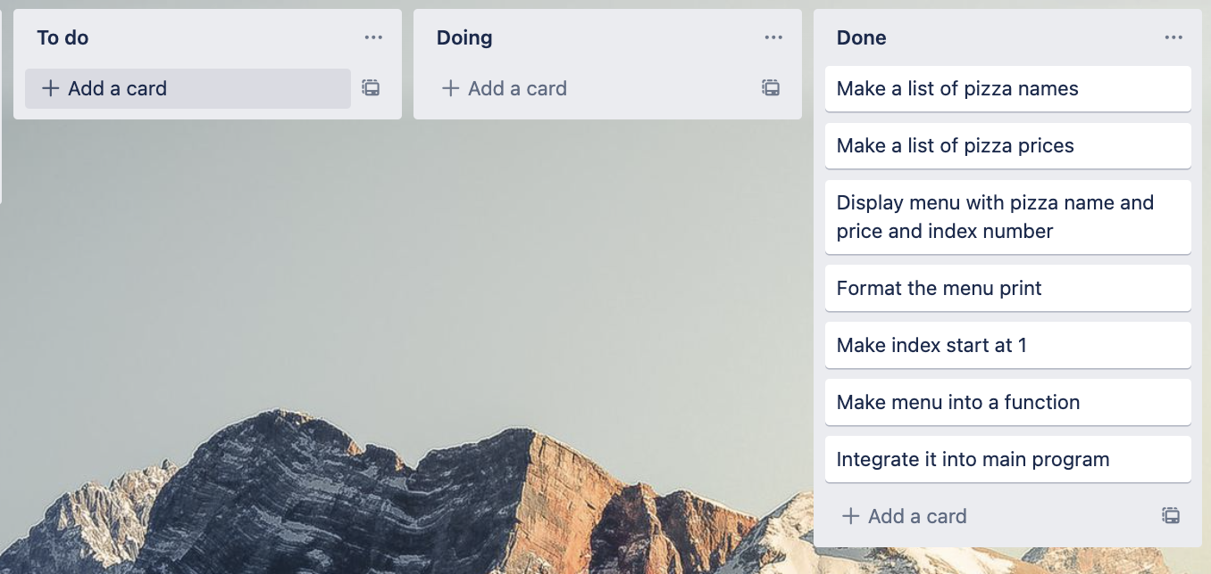
Component 5 Pizza Menu version 3 (Trello screenshot)

Slide 32
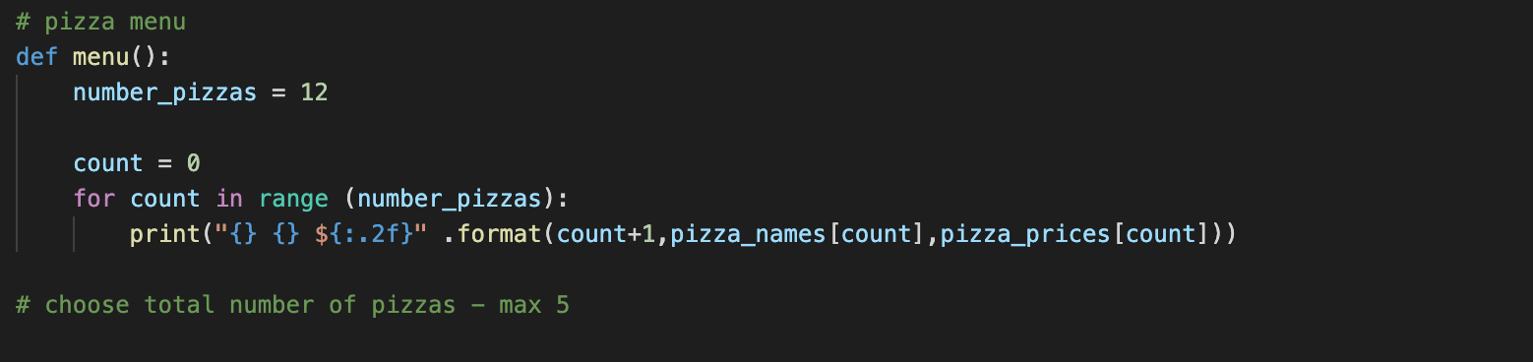
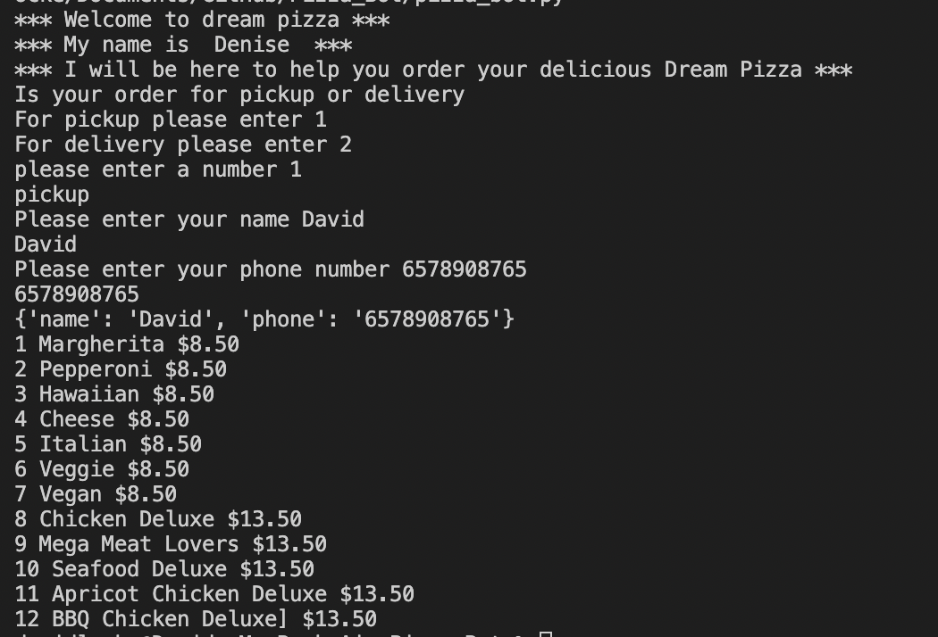
Component 5 integrated in to main program
Test Case | Expected Values
Run file | Printed a list with index number, of pizzas and prices with price formatted to 2 decimal places and dollar sign. Menu starts at 1.

Slide 33
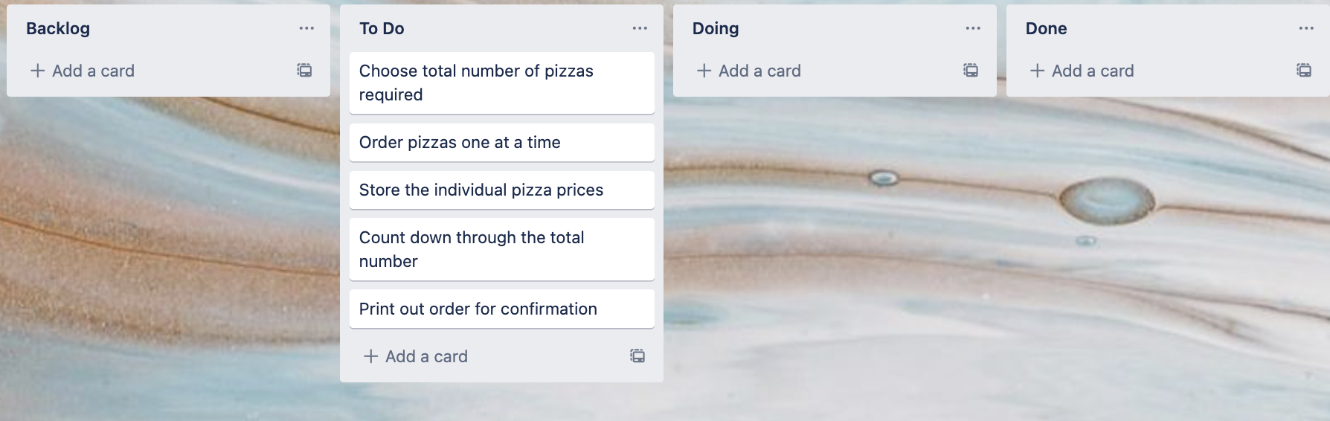
Component 6 Pizza Order v1 (Trello screenshot)

Slide 34
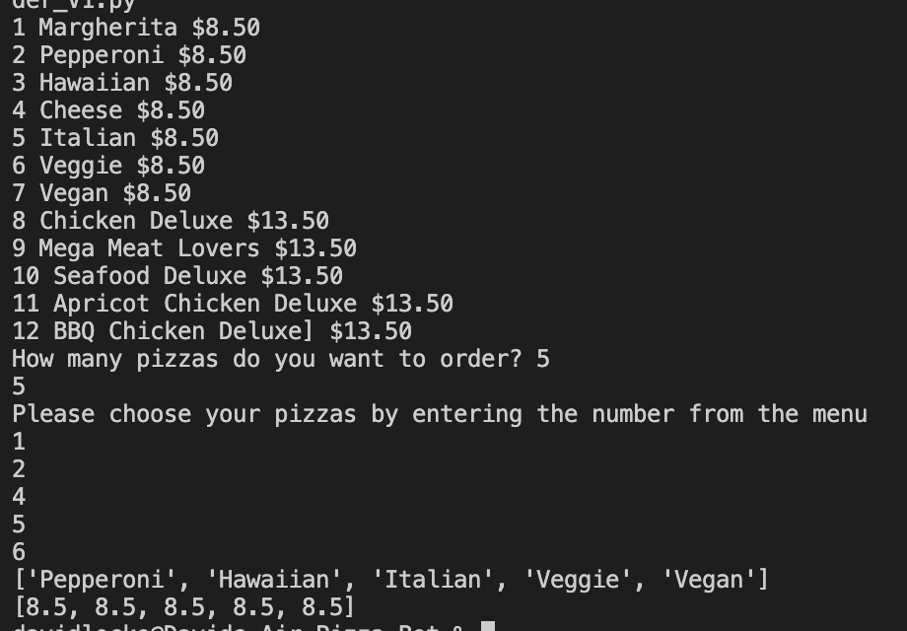
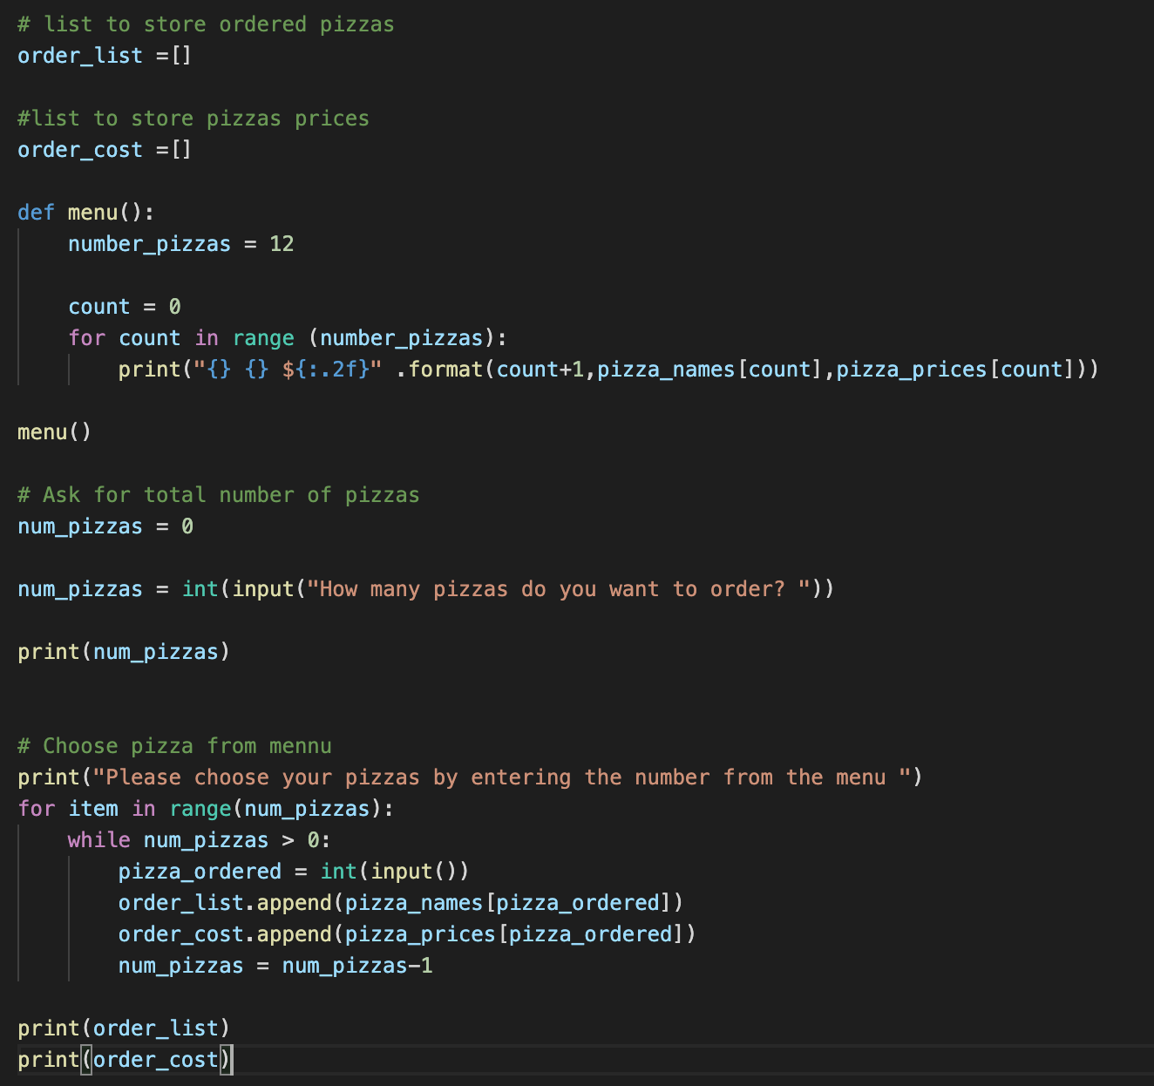
Component 6 – Pizza Order v1 (?and screenshot)
Test Case | Expected Values
Entered 5 pizzas Entered cat | Stepped through the menu choice 5 times Program broke

Slide 35
Component 6 Pizza Order v2or4 (Trello screenshot)

Slide 36


Component 6 – Pizza Order v2or4 (?and screenshot)
Test Case | Expected Values
W % Space 7 0 4 | Not a valid number Not a valid number Not a valid number Must be between 1 and 5 Must be between 1 and 5 Accepted continues to order

Slide 37

Component 6 Pizza Order v3 (Trello screenshot)

Slide 38


Component 6 – Pizza Order v3 (?and screenshot)
Test Case – picking pizza number from menu | Expected Values
W % Space 7 0 4 | Not a valid number Not a valid number Not a valid number Must be between 1 and 5 Must be between 1 and 5 Accepted continues to order

Slide 39

Component 6 Pizza Order v3 (Trello screenshot)

Slide 40

Component 6 – Pizza Order v3 (?and screenshot)
Test Case – picking pizza number from menu | Expected Values
W % Space 7 0 4 | Not a valid number Not a valid number Not a valid number Must be between 1 and 5 Must be between 1 and 5 Accepted continues to order

Slide 41

Component 7 Order print v1 (Trello screenshot)

Slide 42


Component 7 v1- Test Plan (?and screenshot)
Test Case | Expected Values
Ran with test data | Prints correctly

Slide 43

Component 7 Order print v2 (Trello screenshot)

Slide 44


Component 7 v2- Test Plan (?and screenshot)
Test Case | Expected Values
Ran with test data | Prints details but requires some more formatting

Slide 45
Component 7 Order print v3 (Trello screenshot)

Slide 46

Component 7 v3- Test Plan (?and screenshot)
Test Case | Expected Values
Ran with test data | Prints details but requires some more formatting

Slide 47
Component 7 Order print v3 (Trello screenshot)

Slide 48

Component 7 v3- Test Plan (?and screenshot)
Test Case | Expected Values
Ran with test data | Prints details on separate page with formatting

Slide 49

Component 7 Order print v4 (Trello screenshot)

Slide 50


Component 7 v4- Test Plan (?and screenshot)
Test Case | Expected Values
Ran with test data | Function Prints details on separate lines with formatting

Slide 51

Component 7 Order print v5 (Trello screenshot)

Slide 52



Component 7 v5- Test Plan (?and screenshot)
Test Case | Expected Values
Choose Pickup Choose Delivery *** Delivery charge not applied for when delivery is chosen | Pickup worked - printed name and phone Delivery worked – printed name, phone and address

Slide 53

Component 7 Order print v6 (Trello screenshot)

Slide 54


Component 7 v5- Test Plan (?and screenshot)
Test Case | Expected Values
Choose Pickup Choose Delivery | Pickup worked - printed name and phone – no pick up charge added Delivery worked – printed name, phone and address and added $5.00 delivery charge

Slide 55
Component 3 (Trello screenshot)

Slide 56


Component 3 - Test Plan (?and screenshot)
Test Case | Expected Values

Slide 57
Component 3 (Trello screenshot)

Slide 58
Component 3 - Test Plan (?and screenshot)
Test Case | Expected Values

Slide 59
Version Control Evidence
Your version control evidence should go here. This could be in the form of annotated screenshots which show you you managed this process or you could make a brief screencast explaining how you implemented version control.
Notes:
Your version control evidence should go here. This could be in the form of annotated screenshots which show you you managed this process or you could make a brief screencast explaining how you implemented version control.

Slide 60
Discusses how the information from planning, testing and trialling of components assisted in the development of a high-quality outcome
Notes:
Discusses how the information from planning, testing and trialling of components assisted in the development of a high-quality outcome

